Slide 1

Recreating HFS Partitions & Analyzing Unallocated Space
Advanced Forensic Recovery Techniques for macOS
Presenter: [Your Name/Organization]

Slide 2




Evolution of Mac File Systems
1985
2017
HFS
1998
APFS
HFS+
Hierarchical File System. 16-bit allocation blocks. Limited scalability.
Apple File System. 64-bit architecture optimized for flash storage.
Extended. 32-bit allocation, Unicode support, and journaling.
Forensic Note: Legacy HFS volumes are still encountered in historical evidence.

Slide 3


HFS+ Partition Architecture
Core Structures
Management Files
•
Volume Header: Contains boot blocks and volume metadata.
•
Extents Overflow: Manages fragmented file locations.
•
Allocation File: Tracks used vs. free blocks.
•
Attributes File: Stores extended metadata.
•
Catalog File: Stores the directory structure and file records.
•
Journal File: Logs transactions; critical for timeline reconstruction.

Slide 4

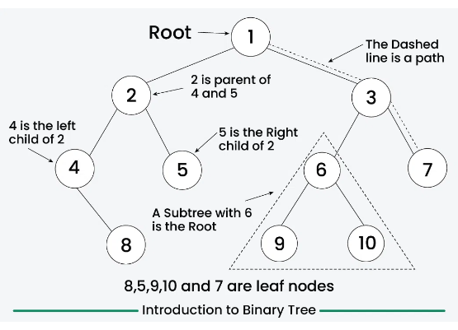
Deep Dive: Metadata & B-Trees
Tree Structure Balanced tree (Header → Index → Leaf) allows for efficient searching of millions of files.
Catalog Records Contains file metadata, directory hierarchy, and thread records essential for navigation.
Recovery Insight Orphaned catalog records often survive deletion. Cross-reference these with the allocation file for recovery.

Slide 5







When is Partition Recovery Necessary?
Corrupted Structures
Deleted Tables
Hidden Evidence
Damage to the Volume Header or Catalog File preventing the OS from mounting the volume.
Partition entries intentionally removed by a suspect to hide an entire volume of evidence.
Critical case data existing in unallocated space requiring manual reconstruction to access.

Slide 6

6-Step Reconstruction Methodology
1. Identify Boundaries Scan sectors for partition start/end signatures.
2. Locate Headers Find primary (offset 1024) and backup headers.
3. Carve Structures Extract allocation bitmaps and extents files.
4. Rebuild Catalog Reconstruct the B-tree structure from leaf nodes.
5. Reconstruct Tree Map parent-child relationships via Node IDs.
6. Validate Data Verify integrity via hashing and consistency checks.

Slide 7


Analyzing Unallocated Space
Definition & Value
Key Components
•
Deleted File Remnants: Full or partial files.
Definition: Unused disk sectors not currently allocated to active files by the file system.
•
File Slack Space: Data between the end of a file and the end of the cluster.
•
Residual Fragments: Data from previous installations or activities.
Forensic Value: Often contains "deleted" data. Since the system only removes the pointer, the raw data remains until overwritten.

Slide 8




Artifacts in Unallocated Space
Deleted Remnants
Residual Fragments
Partial files removed but not yet overwritten. These are prime targets for recovery tools.
Data chunks from partial overwrites or file truncation, often found in slack space.
Magic Numbers
Overwritten Blocks
Header/Footer signatures enabling identification (e.g., FF D8 for JPEG, 25 50 44 46 for PDF).
Sectors reused by the file system. Only non-overwritten blocks retain original data suitable for carving.

Slide 9
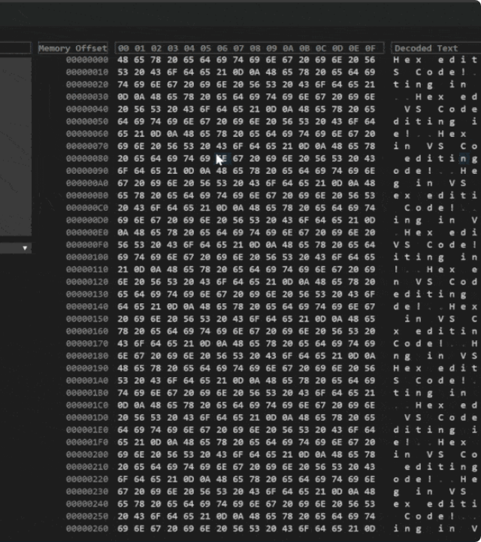
Forensic Analysis Techniques
>
Hex-Level Examination Raw sector analysis to find file structures and specific data patterns manually.
>
File Carving Metadata-independent recovery using header/footer signatures to extract files.
>
Signature Searching Automated scanning for known file types (PDF, ZIP, PLIST).
>
Pattern Matching Using keywords and Regular Expressions (Regex) to find strings like emails or card numbers.

Slide 10
Essential Forensic Tools
Open Source
Commercial
•
TestDisk: Powerful partition recovery.
•
EnCase: Industry standard enterprise suite.
•
Sleuth Kit/Autopsy: Complete analysis platform.
•
FTK (Forensic Toolkit): Known for indexing and processing speed.
•
Scalpel/PhotoRec: File carving based on headers.
•
Bulk Extractor: Scrapes PII, emails, and URLs.
•
Magnet Axiom: Advanced artifact carving and correlation.

Slide 11

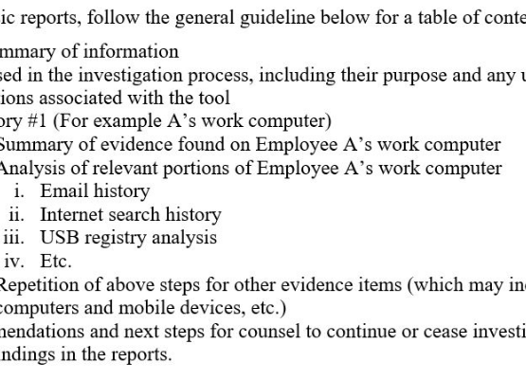
Presenting Findings & Validation
Document Process
Validate
Evidentiary Value

Slide 12




Image Sources
https://media.geeksforgeeks.org/wp-content/uploads/20240811023816/Introduction-to-Binary-Tree.webp
Source: www.geeksforgeeks.org
https://i.sstatic.net/Wha2A.gif
Source: stackoverflow.com
https://www.thomsonreuters.com/en-us/posts/wp-content/uploads/sites/20/2016/08/Forensics-chart.jpg
Source: www.thomsonreuters.com

